Slide 1
WAN Technologies

Slide 2
Overview
Note: Most of this will be described in more detail in later chapters.
Differentiate between a LAN and WAN
Identify the devices used in a WAN
List WAN standards
Describe WAN encapsulation
Classify the various WAN link options
Differentiate between packet-switched and circuit-switched WAN technologies
Compare and contrast current WAN technologies
Describe equipment involved in the implementation of various WAN services
Recommend a WAN service to an organization based on its needs
Describe DSL and cable modem connectivity basics
Describe a methodical procedure for designing WANs
Compare and contrast WAN topologies
Compare and contrast WAN design models
Recommend a WAN design to an organization based on its needs

Slide 3
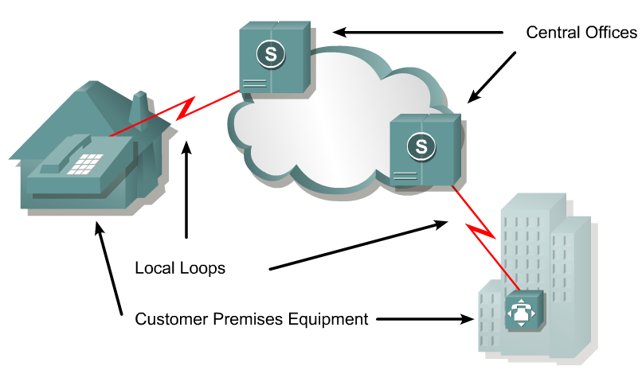
WAN technology/terminology
Devices on the subscriber premises are called customer premises equipment (CPE).
The subscriber owns the CPE or leases the CPE from the service provider.
A copper or fiber cable connects the CPE to the service provider’s nearest exchange or central office (CO).
This cabling is often called the local loop, or "last-mile".

Slide 4
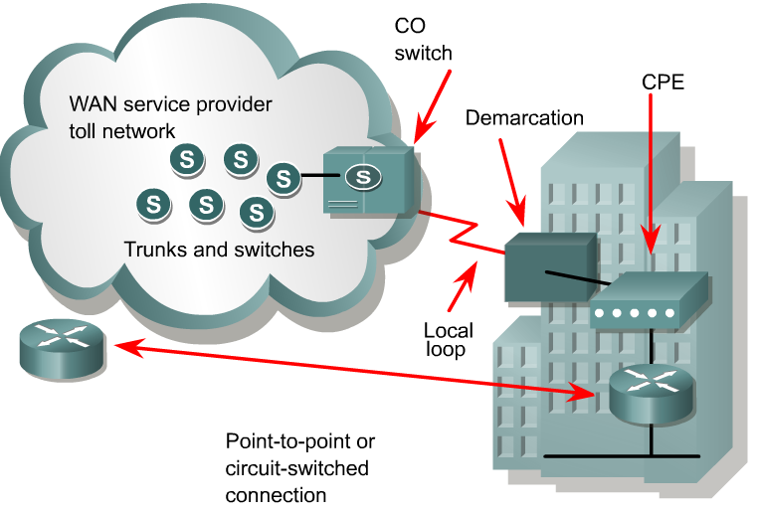
WAN technology/terminology
A dialed call is connected locally to other local loops, or non-locally through a trunk to a primary center.
It then goes to a sectional center and on to a regional or international carrier center as the call travels to its destination.

Slide 5
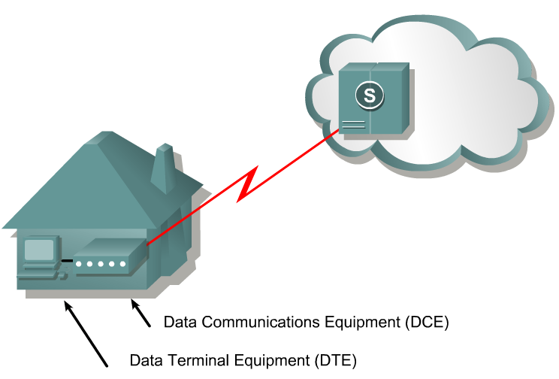
WAN technology/terminology
Devices that put data on the local loop are called data circuit-terminating equipment, or data communications equipment (DCE).
The customer devices that pass the data to the DCE are called data terminal equipment (DTE).
The DCE primarily provides an interface for the DTE into the communication link on the WAN cloud.

Slide 6
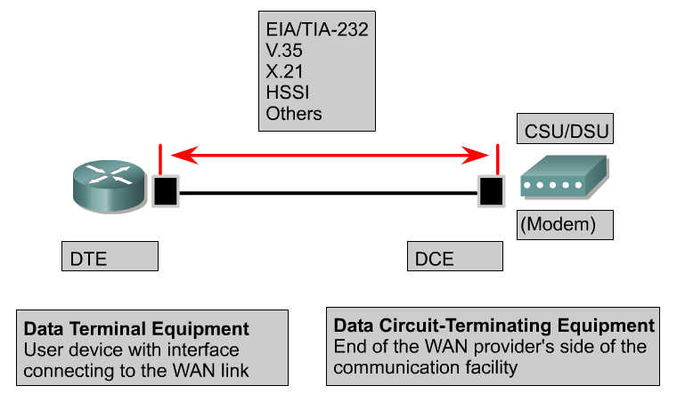
WAN technology/terminology
The DTE/DCE interface uses various physical layer protocols, such as High-Speed Serial Interface (HSSI) and V.35.
These protocols establish the codes and electrical parameters the devices use to communicate with each other.

Slide 7
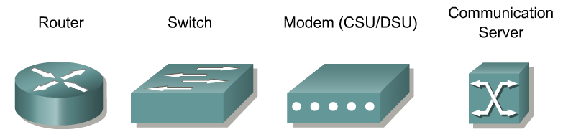
WAN Devices
Frame Relay, ATM, X.25 switch

Slide 8
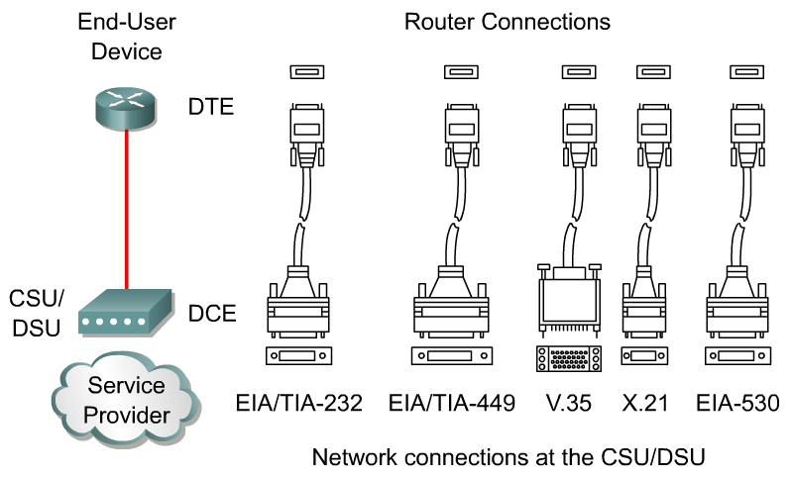
DTE-DCE
The DTE-DCE interface for a particular standard defines the following specifications:
Mechanical/physical – Number of pins and connector type
Electrical – Defines voltage levels for 0 and 1
Functional – Specifies the functions that are performed by assigning meanings to each of the signaling lines in the interface
Procedural – Specifies the sequence of events for transmitting data

Slide 9
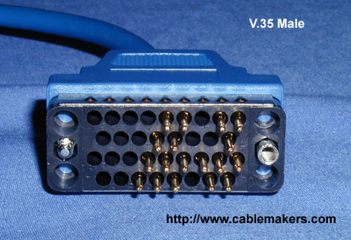
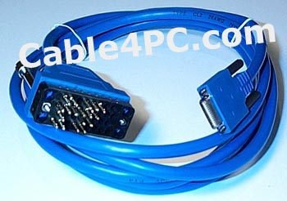
DTE-DCE
DTE Cable
If two DTEs must be connected together, like two computers or two routers in the lab, a special cable called a null-modem is necessary to eliminate the need for a DCE.
For synchronous connections, where a clock signal is needed, either an external device or one of the DTEs must generate the clock signal.
To support higher densities in a smaller form factor, Cisco has introduced a smart serial cable.
The serial end of the smart serial cable is a 26-pin connector significantly more compact than the DB-60 connector.

Slide 10
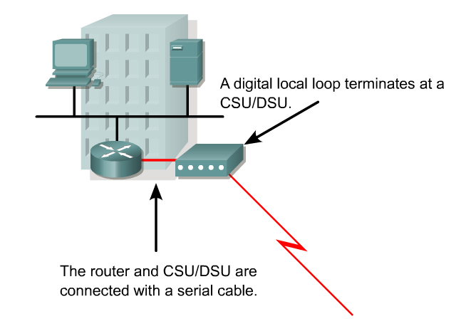
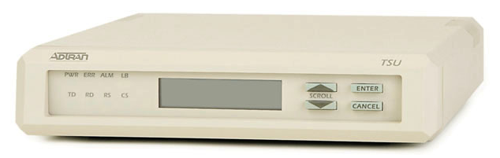
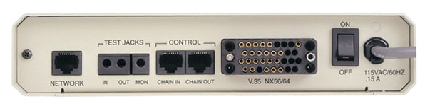
External CSU/DSU
To router
To T1 circuit
For digital lines, a channel service unit (CSU) and a data service unit (DSU) are required.
  We won’t go into the differences here.
The two are often combined into a single piece of equipment, called the CSU/DSU.

Slide 11
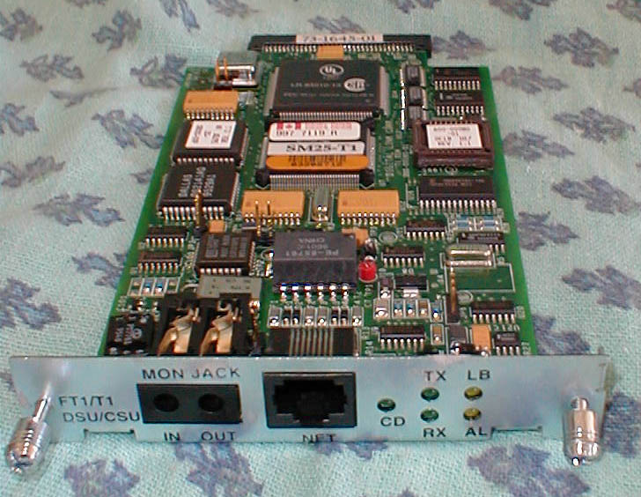
CSU/DSU Interface Card
The CSU/DSU may also be built into the interface card in the router.

Slide 12
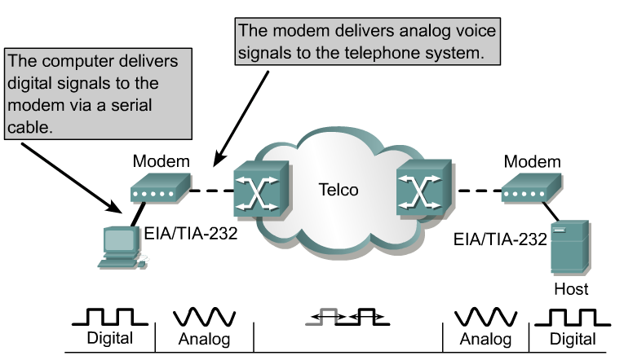
Modems
Modems transmit data over voice-grade telephone lines by modulating and demodulating the signal.
The digital signals are superimposed on an analog voice signal that is modulated for transmission.
The modulated signal can be heard as a series of whistles by turning on the internal modem speaker.
At the receiving end the analog signals are returned to their digital form, or demodulated.

Slide 13
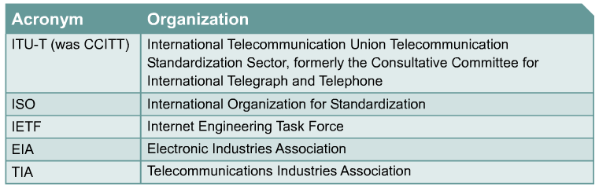
WAN Standards Organizations
WAN standards typically describe both physical layer delivery methods and data link layer requirements, including physical addressing, flow control, and encapsulation.
WAN standards are defined and managed by a number of recognized authorities.

Slide 14
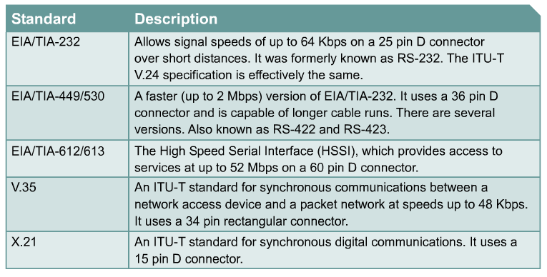
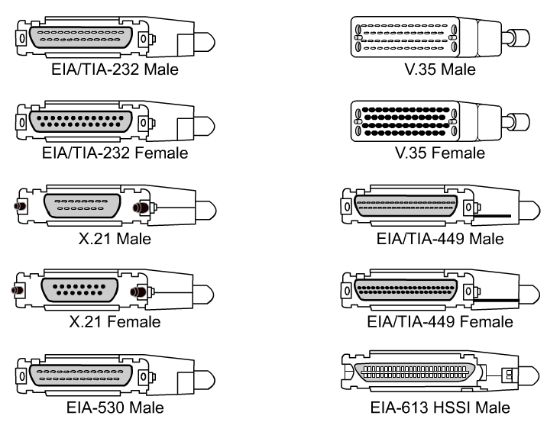
Physical Layer Standards
The physical layer protocols describe how to provide electrical, mechanical, operational, and functional connections to the services provided by a communications service provider.

Slide 15
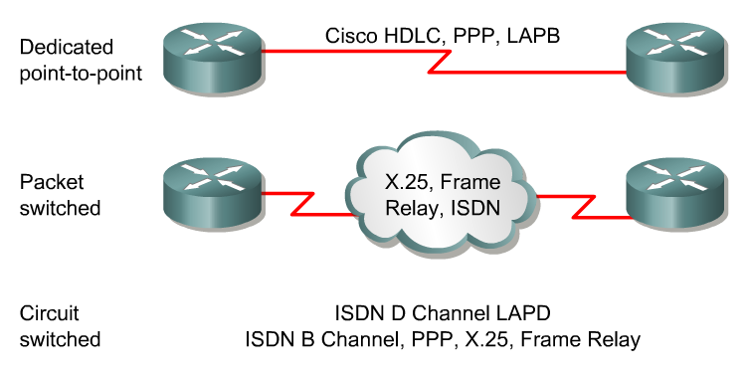
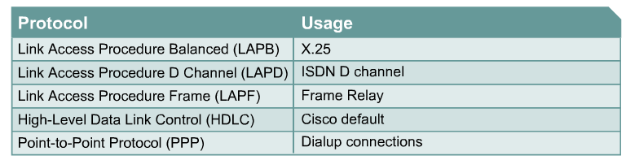
WANs - Data Link Encapsulation
The data link layer protocols define how data is encapsulated for transmission to remote sites, and the mechanisms for transferring the resulting frames.
A variety of different technologies are used, such as ISDN, Frame Relay or Asynchronous Transfer Mode (ATM).
These protocols use the same basic framing mechanism, high-level data link control (HDLC), an ISO standard, or one of its sub-sets or variants.

Slide 16
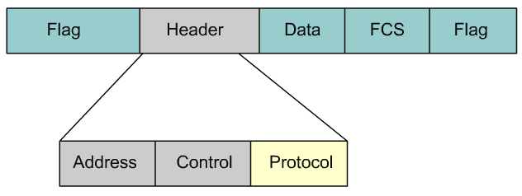
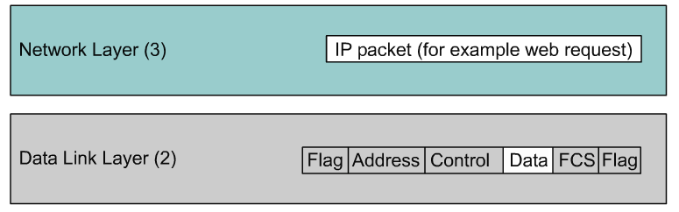
HDLC Framing
The choice of encapsulation protocols depends on the WAN technology and the equipment.
Most framing is based on the HDLC standard.
The address field is not needed for WAN links, which are almost always point-to-point. The address field is still present and may be one or two bytes long.
Several data link protocols are used, including sub-sets and proprietary versions of HDLC.
  Vendors usually use their own proprietary version of HDLC.
Both PPP and the Cisco version of HDLC have an extra field in the header to identify the network layer protocol of the encapsulated data.

Slide 17
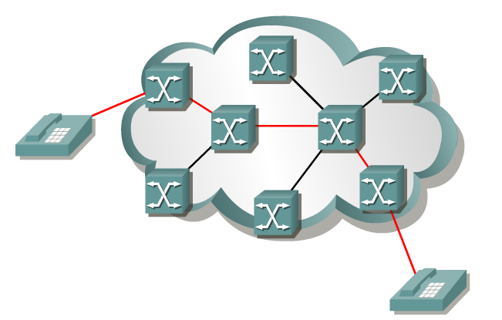
Circuit Switched
ISDN
When a subscriber makes a telephone call (or ISDN), the dialed number is used to set switches in the exchanges along the route of the call so that there is a continuous circuit from the originating caller to that of the called party.
The internal path taken by the circuit between exchanges is shared by a number of conversations.
Time division multiplexing (TDM) is used to give each conversation a share of the connection in turn.
TDM assures that a fixed capacity connection is made available to the subscriber.

Slide 18
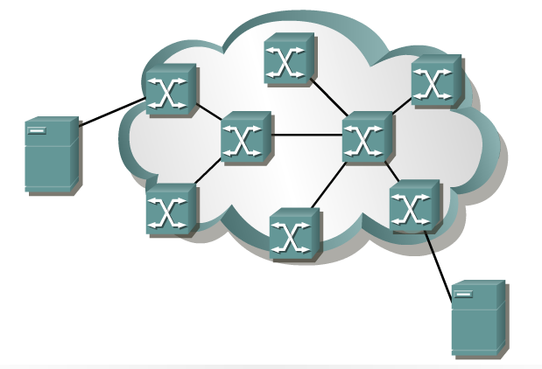
Packet Switching
Frame Relay, X.25, ATM
An alternative is to allocate the capacity to the traffic only when it is needed, and share the available capacity between many users.
With a circuit-switched connection, the data bits put on the circuit are automatically delivered to the far end because the circuit is already established.
If the circuit is to be shared, there must be some mechanism to label the bits so that the system knows where to deliver them.
It is difficult to label individual bits, therefore they are gathered into groups called cells, frames, or packets.
The packet passes from exchange to exchange for delivery through the provider network.
Networks that implement this system are called packet-switched networks.

Slide 19
Packet Switching
Frame Relay, X.25, ATM
Packet-switched describes the type of network in which relatively small units of data called packets are routed through a network based on the destination address contained within each packet.
Packet Switching allows the same data path to be shared among many users in the network.
This type of communication between sender and receiver is known as connectionless (rather than dedicated).
Most traffic over the Internet uses packet switching and the Internet is basically a connectionless network.

Slide 20
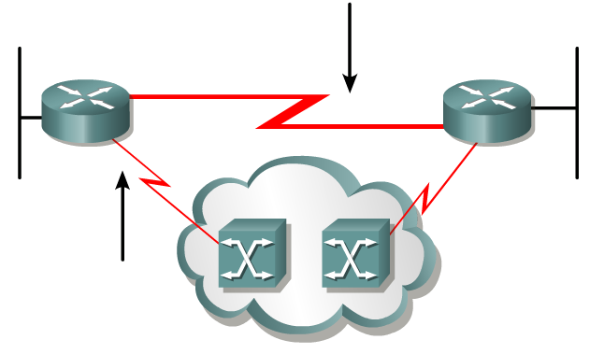
Using Leased lines to the WAN Cloud
To connect to a packet-switched network, a subscriber needs a local loop to the nearest location where the provider makes the service available.
This is called the point-of-presence (POP) of the service.
Normally this will be a dedicated leased line.
This line will be much shorter than a leased line directly connected to the subscriber locations, and often carries several VCs.
Since it is likely that not all the VCs will require maximum demand simultaneously, the capacity of the leased line can be smaller than the sum of the individual VCs.

Slide 21
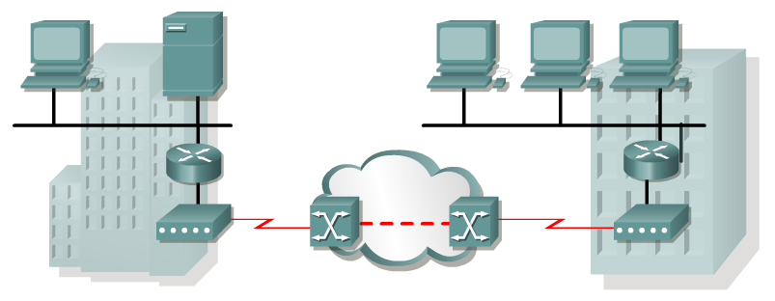
Analog Dialup
When intermittent, low-volume data transfers are needed, modems and analog dialed telephone lines provide low capacity and dedicated switched connections.

Slide 22
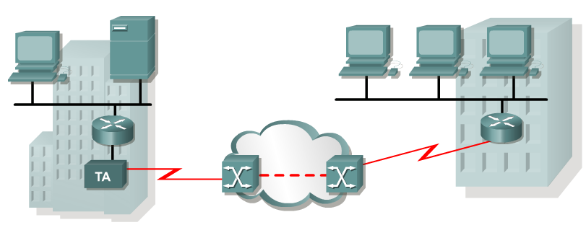
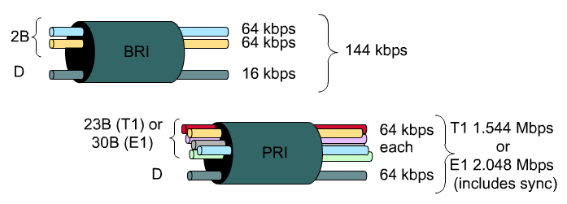
ISDN
Integrated Services Digital Network (ISDN) turns the local loop into a TDM digital connection.
  Usually requires a new circuit.
The connection uses 64 kbps bearer channels (B) for carrying voice or data and a signaling, delta channel (D) for call set-up and other purposes.
Never really became popular in the U.S., known as It-Still-Does-Nothing or I-Still-Don’t Know

Slide 23
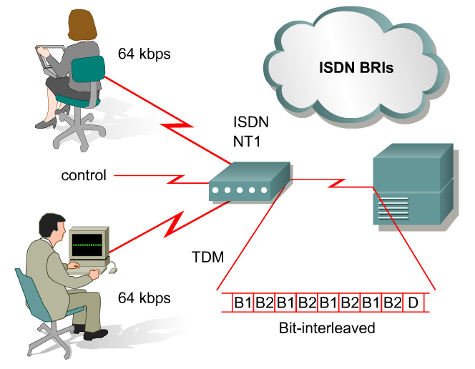
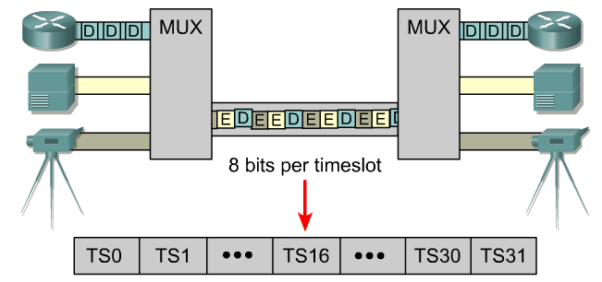
Time Division Multiplexing
Time-Division Multiplexing (TDM) is the transmission of several sources of information using one common channel, or signal, and then the reconstruction of the original streams at the remote end.
In TDM, the output timeslot is always present whether or not the TDM input has any information to transmit.
One TDM example is Integrated Services Digital Network (ISDN). ISDN basic rate (BRI) has three channels consisting of two 64 kbps B-channels (B1 and B2), and a 16 kbps D-channel.
The TDM has nine timeslots, which are repeated.

Slide 24
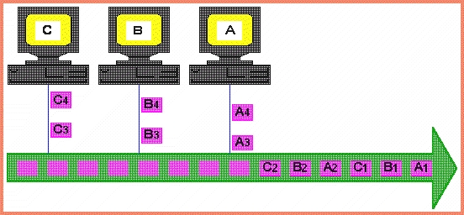
Time Division Multiplexing (TDM)
Two or more “channels” of information are transmitted over the same link by allocating a different time interval for the transmission of each channel, i.e. the channels take turns to use the link.
Some kind of periodic synchronizing signal or distinguishing identifier is required so that the receiver can tell which channel is which.
TDM becomes inefficient when traffic is intermittent because the time slot is still allocated even when the channel has no data to transmit

Slide 25
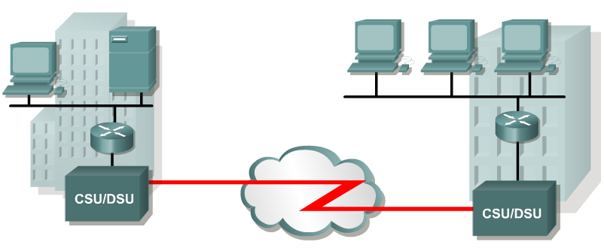
Leased Lines
A point-to-point link provides a pre-established WAN communications path from the customer premises through the provider network to a remote destination.
Point-to-point lines are usually leased from a carrier and are called leased lines.
Leased lines are available in different capacities.
Leased lines provide direct point-to-point connections between enterprise LANs and connect individual branches to a packet-switched network.

Slide 26
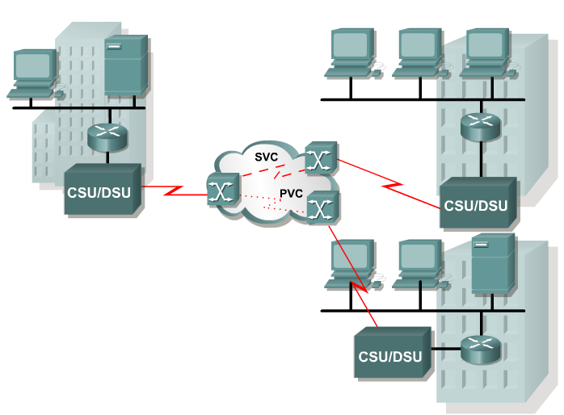
X.25
The first of these packet-switched networks was standardized as the X.25 group of protocols.
X.25 provides a low bit rate shared variable capacity that may be either switched or permanent.
X.25 is a network-layer protocol and subscribers are provided with a network address.
Virtual circuits can be established through the network with call request packets to the target address.
The resulting SVC is identified by a channel number. X.25 technology is no longer widely available as a WAN technology in the US.
Frame Relay has replaced X.25 at many service provider locations.

Slide 27
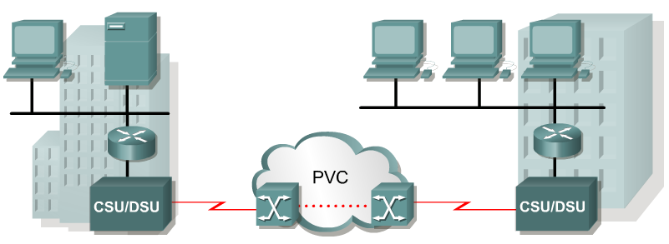
Frame Relay
Frame Relay differs from X.25 in several aspects.
Most importantly, it is a much simpler protocol that works at the data link layer rather than the network layer.
Frame Relay implements no error or flow control.
The simplified handling of frames leads to reduced latency, and measures taken to avoid frame build-up at intermediate switches help reduce jitter.
Most Frame Relay connections are PVCs rather than SVCs.
Frame Relay provides permanent shared medium bandwidth connectivity that carries both voice and data traffic.

Slide 28
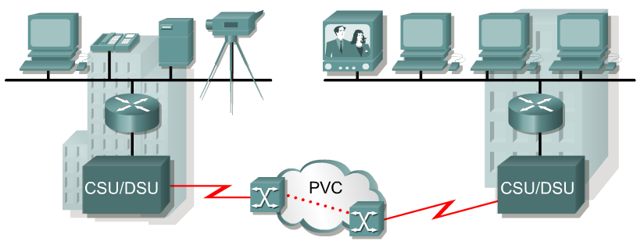
ATM
Communications providers saw a need for a permanent shared network technology that offered very low latency and jitter at much higher bandwidths.
Their solution was Asynchronous Transfer Mode (ATM). ATM has data rates beyond 155 Mbps.
As with the other shared technologies, such as X.25 and Frame Relay, diagrams for ATM WANs look the same.

Slide 29
ATM
ATM is a technology that is capable of transferring voice, video, and data through private and public networks.
It is built on a cell-based architecture rather than on a frame-based architecture.
ATM cells are always a fixed length of 53 bytes.
The 53 byte ATM cell contains a 5 byte ATM header followed by 48 bytes of ATM payload.
Small, fixed-length cells are well suited for carrying voice and video traffic because this traffic is intolerant of delay.
Video and voice traffic do not have to wait for a larger data packet to be transmitted.
The 53 byte ATM cell is less efficient than the bigger frames and packets of Frame Relay and X.25.
Furthermore, the ATM cell has at least 5 bytes of overhead for each 48-byte payload.
A typical ATM line needs almost 20% greater bandwidth than Frame Relay to carry the same volume of network layer data.

Slide 30
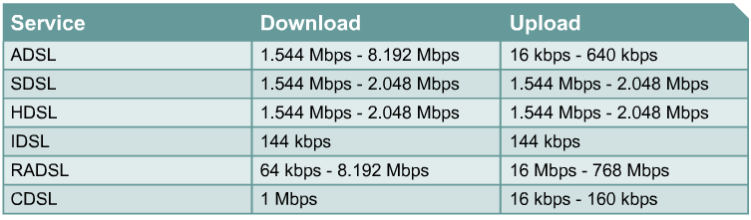
DSL
Digital Subscriber Line (DSL) technology is a broadband technology that uses existing twisted-pair telephone lines to transport high-bandwidth data to service subscribers.
The term xDSL covers a number of similar yet competing forms of DSL technologies.
DSL technology allows the local loop line to be used for normal telephone voice connection and an always-on connection for instant network connectivity. The two basic types of DSL technologies are asymmetric (ADSL) and symmetric (SDSL).
All forms of DSL service are categorized as ADSL or SDSL and there are several varieties of each type.
Asymmetric service provides higher download or downstream bandwidth to the user than upload bandwidth.
Symmetric service provides the same capacity in both directions.

Slide 31
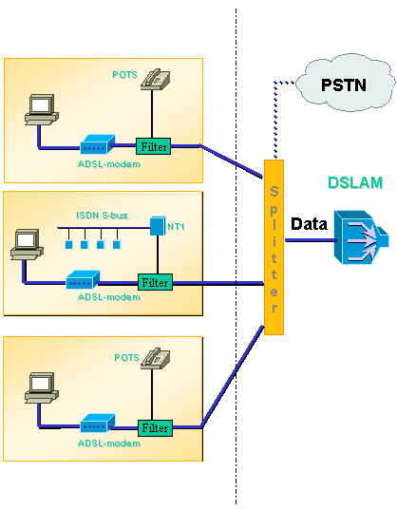
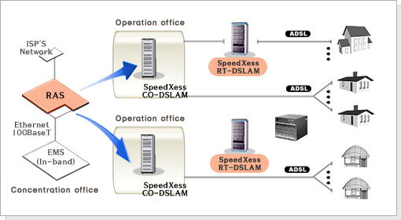
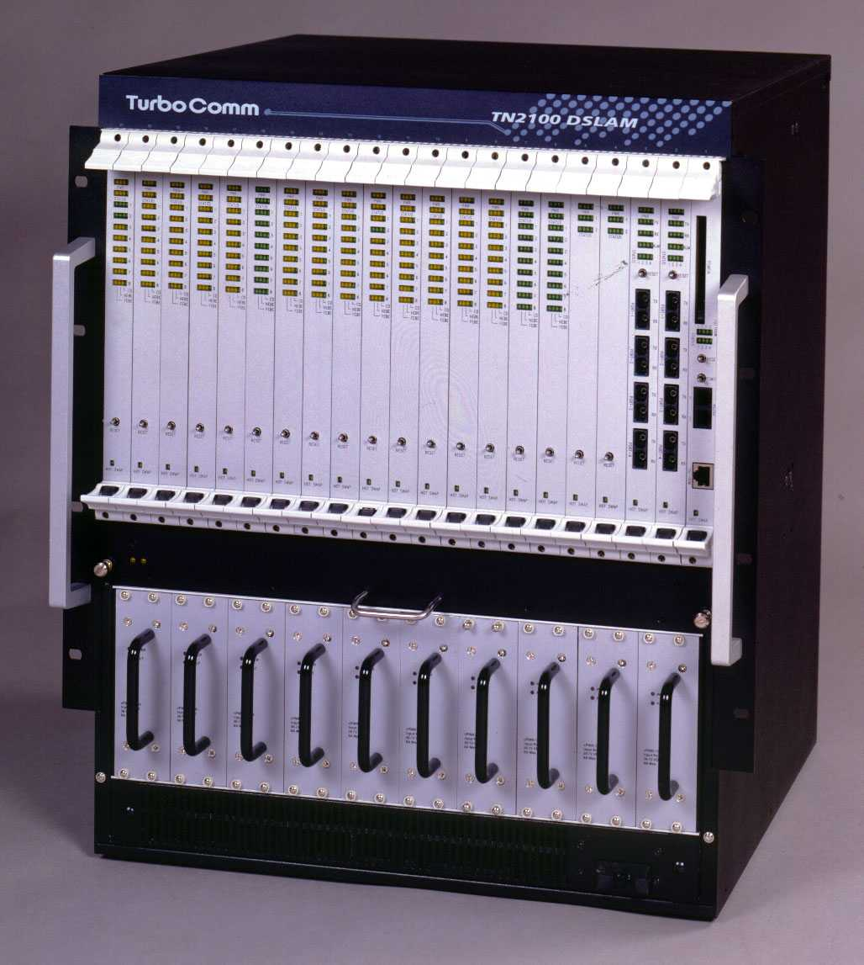
DSL
english.speedxess.net
Multiple DSL subscriber lines are multiplexed into a single, high capacity link by the use of a DSL Access Multiplexer (DSLAM) at the provider location.
DSLAMs incorporate TDM technology to aggregate many subscriber lines into a less cumbersome single medium, generally a T3/DS3 connection techniques to achieve data rates up to 8.192 Mbps.

Slide 32
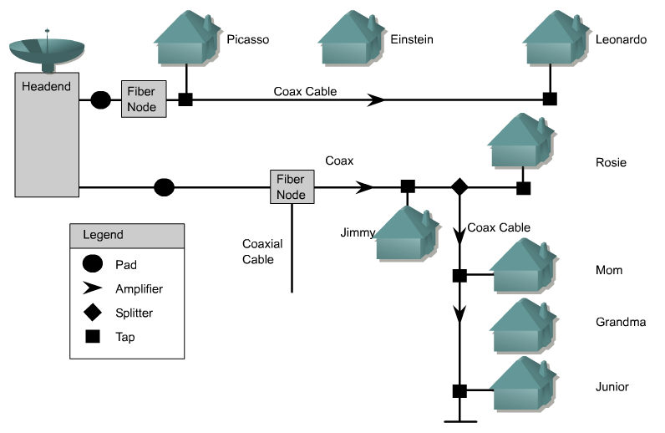
Cable Modem
Coaxial cable is widely used in urban areas to distribute television signals.
This allows for greater bandwidth than the conventional telephone local loop.
Enhanced cable modems enable two-way, high-speed data transmissions using the same coaxial lines that transmit cable television.
Some cable service providers are promising data speeds up to 6.5 times that of T1 leased lines.

Slide 33
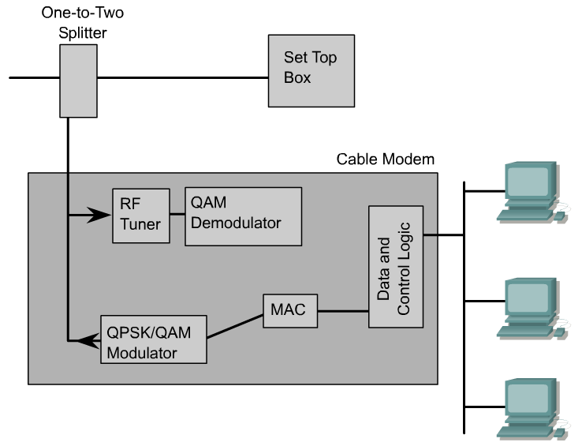
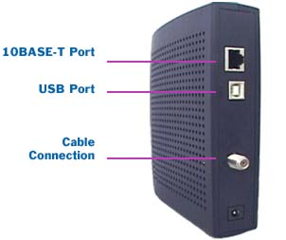
Cable Modem
www.twcarolina.com
Cable modems provide an always-on connection and a simple installation.
A cable modem is capable of delivering up to 30 to 40 Mbps of data on one 6 MHz cable channel.
With a cable modem, a subscriber can continue to receive cable television service while simultaneously receiving data to a personal computer.
This is accomplished with the help of a simple one-to-two splitter.

Slide 34
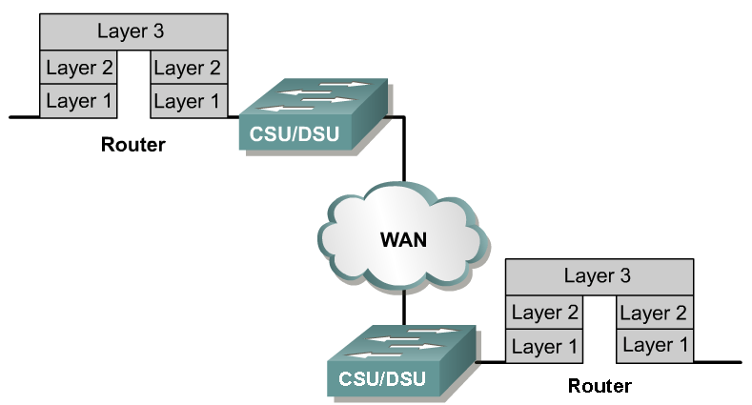
WAN Communication
?
WAN protocols operate at only the lower TWO layers of the OSI stack.

Slide 35
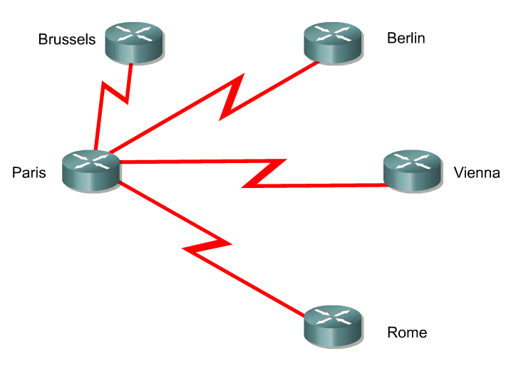
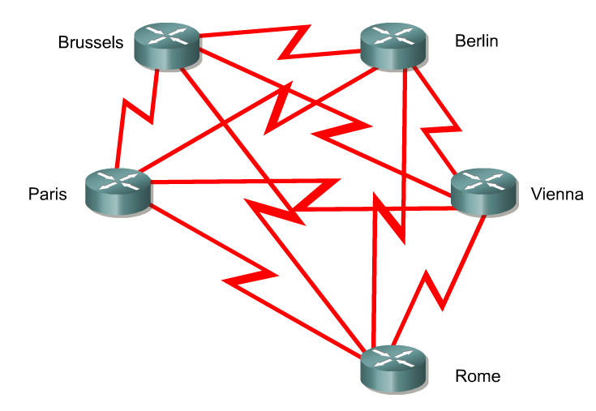
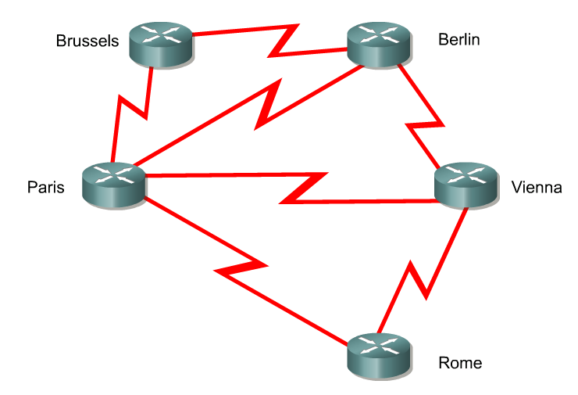
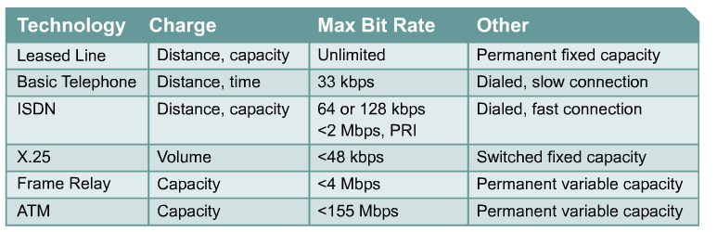
WAN Topologies
Full-Mesh
Star or Hub-and-Spoke
Partial-Mesh
>155 Mbps
<45 Mbps

Slide 36
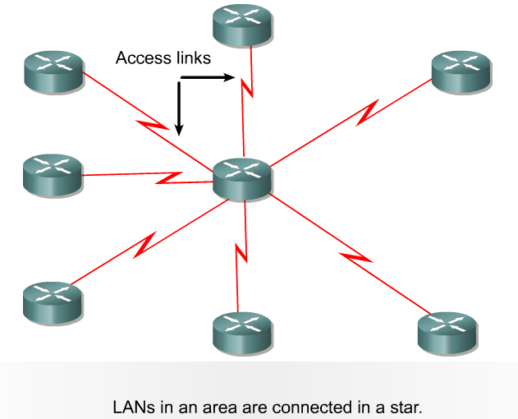
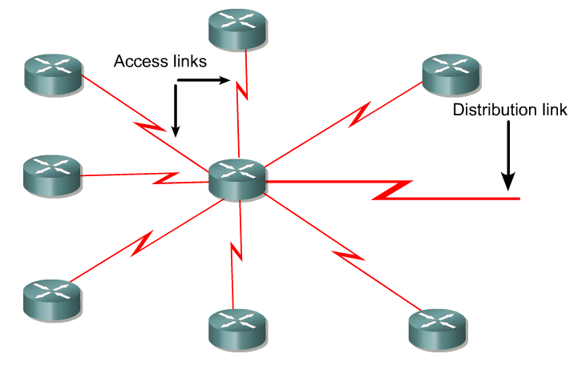
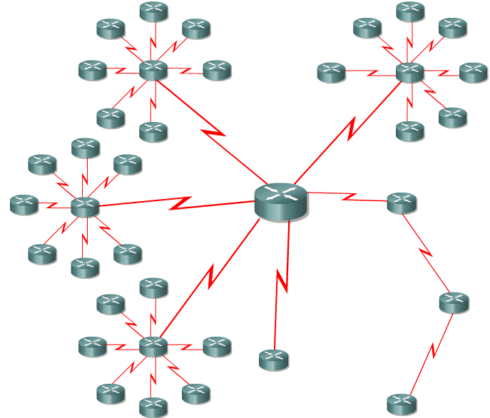
Three-layer design model (WAN version)

Slide 37
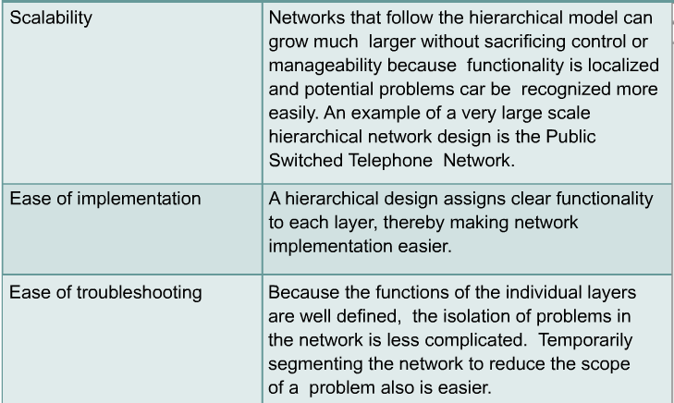
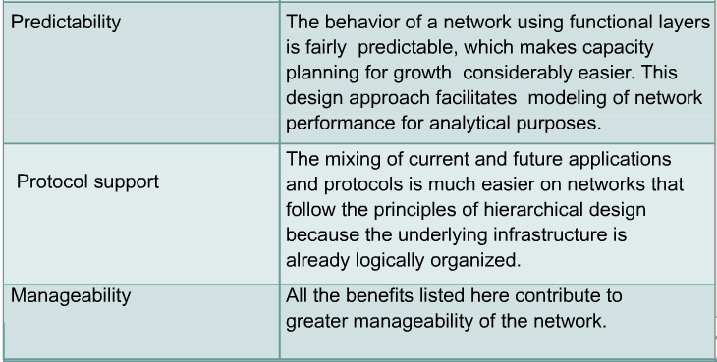
Advantages of a Hierarchical Approach

Slide 38

Another Three Layer Model

Slide 39

WAN Considerations
Many enterprise WANs will have connections to the Internet.
This provides an alternative for inter-branch connections.
Since the Internet probably exists everywhere that the enterprise has LANs, there are two principal ways that this traffic can be carried.
Each LAN can have a connection to its local ISP, or there can be a single connection from one of the core routers to an ISP.
The advantage is that traffic is carried on the Internet rather than on the enterprise network, possibly leading to smaller WAN links.

Slide 40
WAN Considerations
The disadvantage of permitting multiple links, is that the whole enterprise WAN is open to Internet-based attacks.
It is also difficult to monitor and secure the many connection points.
A single connection point is more easily monitored and secured, even though the enterprise WAN will be carrying some traffic that would otherwise have been carried on the Internet.

